Slide 1
Networking Media
Chapter 3

Slide 2
Learning Objectives
Define and understand technical terms relating to cabling, including attenuation, crosstalk, shielding, and plenum
Identify three major types of network cabling and of wireless network technologies
Understand baseband and broadband transmission technologies and when to use each

Slide 3
Learning Objectives
Decide what kinds of cabling and connections are appropriate for particular network environments
Describe wireless transmission technologies used in LANs
Describe signaling technologies for mobile computing

Slide 4
Network Cabling: Tangible Physical Media
Media allows data to enter and leave computer
May be cables or wireless communications
Interface between computer and medium defines form for outgoing messages
Different kinds of media, both wired and wireless, have limitations
Consider cost and performance when choosing network cabling

Slide 5
Primary Cable Types
Cables provide medium across which network information travels either as electrical transmissions or light pulses
Three most commonly-used kinds of network cabling are:
Coaxial
Twisted-pair (TP), both unshielded (UTP) and shielded (STP) varieties
Fiber-optic

Slide 6
General Cable Characteristics
All cables share these fundamental characteristics:
Bandwidth rating
Maximum segment length
Maximum number of segments per internetwork
Maximum number of devices per segment
Interference susceptibility
Connection hardware
Cable grade
Bend radius
Material costs
Installation costs

Slide 7
General Cable Characteristics
Bandwidth rating – how many bits or bytes cable can carry over unit of time, usually megabits per second (Mbps)
Maximum segment length – how long data may be transported before signal begins to weaken (called attenuation)
Defines range where signals can be regenerated correctly and retransmitted accurately

Slide 8
General Cable Characteristics
Maximum number of segments per internetwork – maximum number of interconnected segments before latency becomes problem
Latency measures how long it takes signal to travel from one end of cable to another
Maximum number of devices per segment – each additional network device attached to cable causes insertion loss
True maximum = rated maximum – (insertion losses)

Slide 9
General Cable Characteristics
Interference susceptibility – measures cables susceptibility to environmental interferences such as electromagnetic interference (EMI) or radio frequency interference (RFI)
Susceptibility is measured as none, low, moderate, and high
Connection hardware – kind of connectors that attach cables; may affect cost of network installation

Slide 10
General Cable Characteristics
Cable grade – specific cabling requirements for building and fire codes, include combustibility and toxicity of cladding (sheath material) and insulation.
Bend radius – how much cables may be bent before they are damaged or destroyed
Material costs – how much cable costs per unit length
Installation costs – includes labor and auxiliary equipment

Slide 11
Baseband and Broadband Transmission
Baseband transmissions use digital encoding scheme at single, fixed frequency
Signals are discrete pulses of electricity or light
Uses entire bandwidth of cable to transmit single data signal
Limited to half-duplex (transmission only one direction at a time)
Use repeaters to refresh signals before transmitting them to another cable segment

Slide 12
Baseband and Broadband Transmission
Broadband transmissions are analog
Move across medium as continuous electromagnetic or optical waves
Flow only one way (simplex)
Needs two channels for computer to send and receive data (full-duplex)
May operate multiple analog transmission channels on single broadband cable
Amplifiers interlink cable segments to strengthen weak signals and rebroadcast them

Slide 13
Baseband and Broadband Transmission
Broadband requires two channels to send and receive
Two primary approaches to two-way broadband communications:
Mid-split broadband – uses single cable but divides bandwidth into two channels, each on different frequency
Dual-cable broadband – uses two cables connected simultaneously to each computer
Broadband offers higher bandwidths than baseband, but is generally more expensive

Slide 14
The Importance of Bandwidth
The faster the connection, the better
Video teleconferencing, streaming audio and video and other powerful services require more bandwidth
As application developers build software requiring more bandwidth, networks must supply ever-higher amounts of bandwidth

Slide 15
Coaxial Cable
Predominant form of network cabling for many years
Inexpensive and relatively easy to install
Has single conductor at core, surrounded by insulating layer, braided metal shielding (called braiding), and outer cover (called sheath or jacket)
See Figure 3-1
Less susceptible to interference and attenuation than twisted-pair cabling

Slide 16
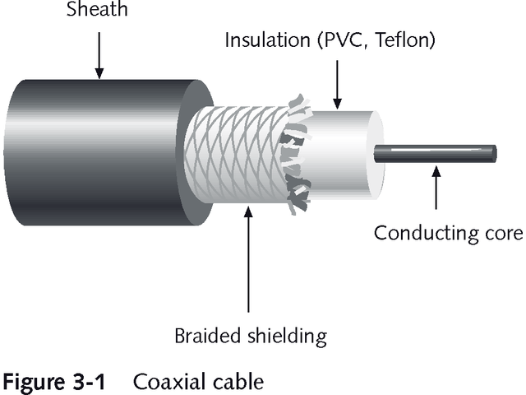
Coaxial Cable

Slide 17
Types of Coaxial Cable
Ethernet uses two types of coaxial cable:
Thin Ethernet (also called thinnet, thinwire, or cheapernet) designated by Institute of Electrical and Electronics Engineers (IEEE) as 10Base2
Thick Ethernet (also called thicknet or thickwire) designated by IEEE as 10Base5

Slide 18
Understanding IEEE Cable Designations
Cable designations refer to total bandwidth (10 Mbps), baseband signaling, and rough value of maximum segment length
Maximum segment length is designated in hundreds of meters
10Base2 means 200 meters but was reduced to 185 meters to compensate for patch cables
10Base5 means 500 meters

Slide 19
Thinwire Ethernet (a.k.a. Thinnet)
Thin flexible cable, approximately .25” diameter
Easy to work with
Inexpensive
Well-suited for small or constantly changing networks
Connects using BNC T-connectors, as shown in Figure 3-2

Slide 20
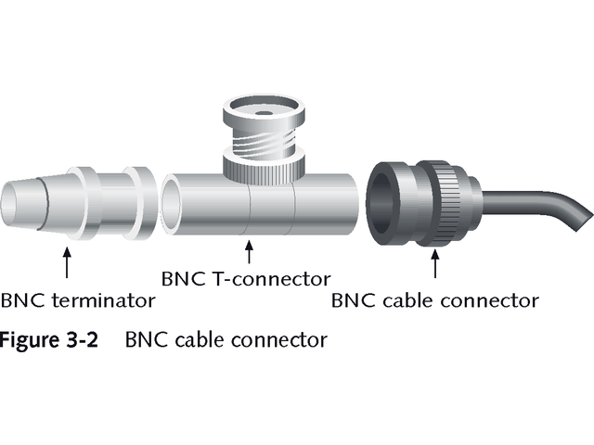
BNC Cable Connector

Slide 21
RG Cable Specifications
Cable manufacturers designate Radio Government (RG) specifications for various types of cable
Thinnet belongs to RG-58 family
Has impedance (electrical resistance to current) of 50 ohms
Table 3-1 compares members of RG cable family

Slide 22
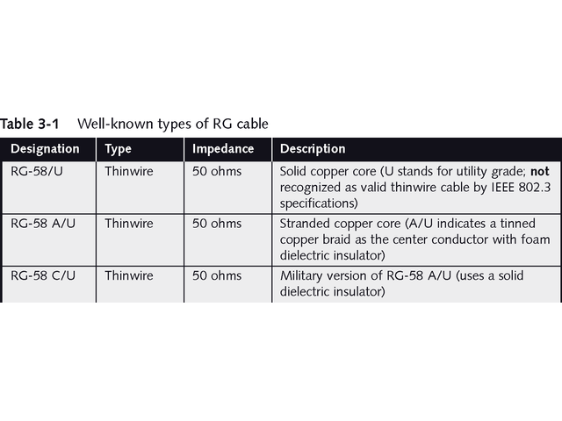
Well-Known Types of RG Cable

Slide 23
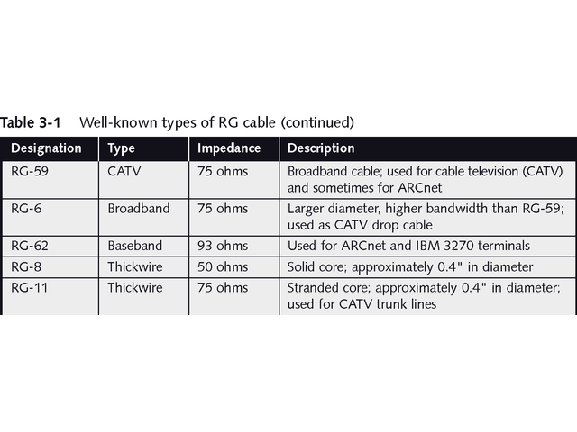
Well-Known Types of RG Cable

Slide 24
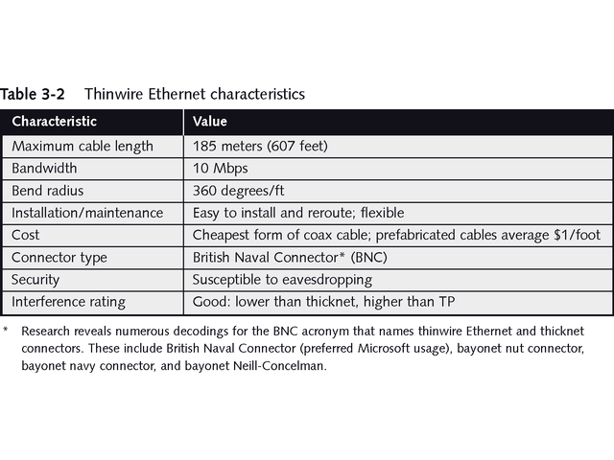
Characteristics of Thinwire Ethernet

Slide 25
Thickwire Ethernet (a.k.a. Thicknet)
Rigid coaxial cable about .4” in diameter
Often covered with bright-yellow Teflon coating
Also called Standard Ethernet
More expensive and less flexible than thinnet
Less interference and better conductivity
Supports longer maximum cable length and more devices in single segment
Commonly used for backbones

Slide 26
Thickwire Ethernet
Usually connected with vampire tap attached to transceiver (transmitter/receiver)
Transceiver attaches to drop of transceiver cable that plugs into attachment unit interface (AUI) on NIC
Figure 3-3 shows BNC-T connector for thinwire Ethernet
Figure 3-4 shows vampire tap and transceiver used with Thicknet

Slide 27
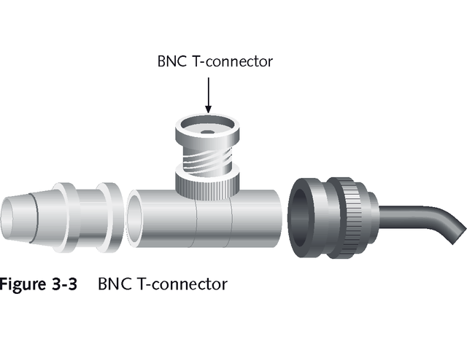
BNC T-Connector with Thinnet

Slide 28
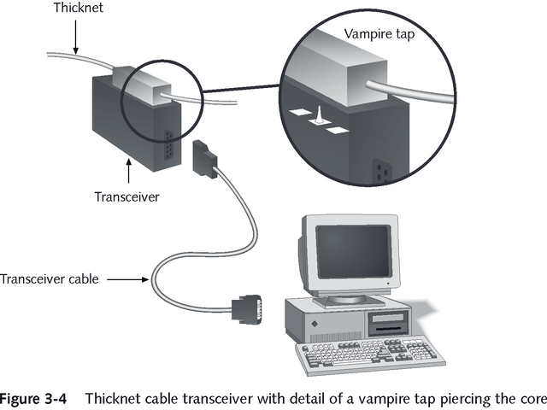
Tranceiver and Vampire Tap with Thicknet

Slide 29
Thickwire Ethernet
Transceiver cables may be up to 50 meters long
Transceivers and transceiver cables make thickwire more expensive than thinwire
Table 3-3 summarizes characteristics of thickwire
All types of Ethernet coaxial cable require terminators at each end of the cable
Terminators prevent signal bounce that may interfere with network traffic

Slide 30
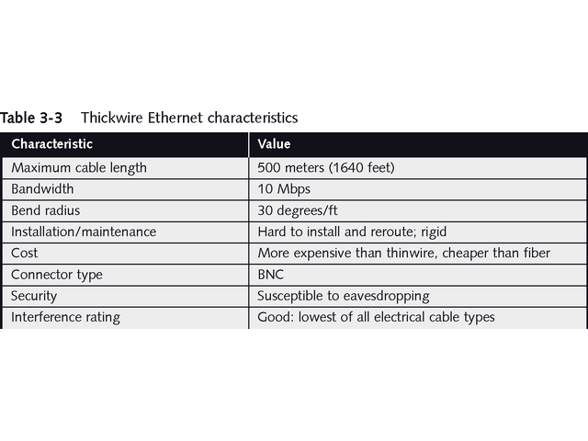
Thickwire Ethernet Characteristics

Slide 31
Advantages and Disadvantages of Coaxial Cable
Advantages
Ability to carry signals relatively long distances
Resistance to interference
Disadvantages
Relatively low bandwidth
Expensive

Slide 32
Coaxial Cable in Cable Modem Applications
Coaxial cable is becoming obsolete in LANs, but increasing in use for accessing Internet
Cable television uses standard 75 Ohm, RG-59 coaxial cable
Cable modem Internet access uses broadband technology to carry data and television channels on same cable
See Figure 3-5

Slide 33
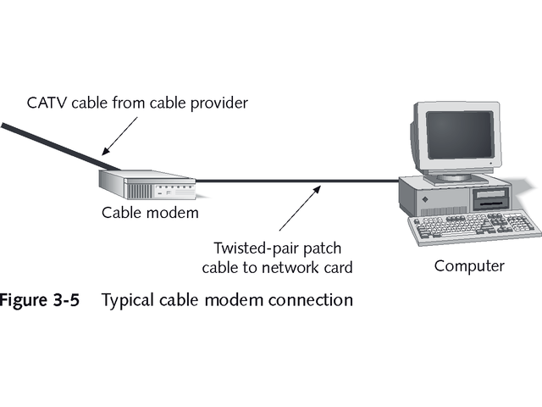
Cable Modem Connection

Slide 34
Other Coaxial Cable Types
Coaxial cable also used for other networks including ARCnet (attached resource computing network)
Older networking technology developed at DataPoint Corporation in 1980s
Supports bandwidth of only 2.5 Mbps
Uses 93 ohm RG-62 coaxial cable originally developed to attach IBM 3270 terminals to mainframe
Also works with 75-ohm RG-59 coaxial cable, fiber-optic, and twisted-pair

Slide 35
Twisted-Pair Cable
TP is simply two or more pairs of insulated copper wires twisted around each other
Improves resistance to interference
Limits crosstalk
The more twists, the better
Two primary types of TP cable
Unshielded twisted-pair (UTP)
Shielded twisted pair (STP)
See Figure 3-6

Slide 36
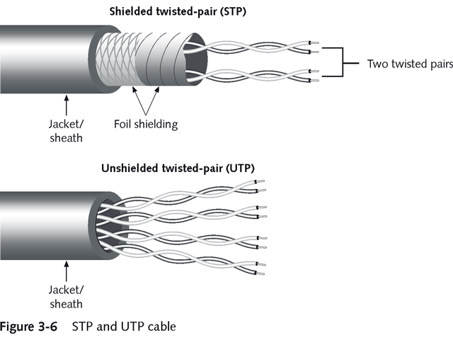
STP and UTP Cable

Slide 37
Unshielded Twisted-Pair (UTP)
IEEE specifies most popular form of LAN cabling as 10BaseT
T means UTP
10 represents 10 Mbps transmission speed
Maximum length of 10BaseT segment is 100 meters
UTP also used for telephone systems

Slide 38
UTP Standards
Electronics Industries Association (EIA) and Telecommunications Industries Association (TIA) rate UTP cabling
American National Standards Institute (ANSI) endorses standards
Known as ANSI/EIA/TIA 568 standard
Currently five categories of unshielded twisted-pair

Slide 39
UTP Categories
Category 1: carries voice not not data
Category 2: bandwidth up to 4 Mbps; too slow for most networks
Category 3: bandwidth up to 10 Mbps; used with older networks such as 10BaseT Ethernet
Category 4: bandwidth up to 16 Mbps; used primarily for 10BaseT Ethernet and 16 Mbps token ring
Category 5: bandwidth up to 100 Mbps; used with 100BaseT Ethernet, ATM, and FDDI

Slide 40
UTP Categories
Category 5E: Enhanced UTP cabling specified by EIA/TIA 568A; used for Gigabit Ethernet; standard for new installations
Category 6: not completely defined, but expected to become standard for Gigabit Ethernet
Category 7: currently in development, will specify fully shielded TP cable with each wire pair shielded

Slide 41
Shielded Twisted-Pair (STP)
Reduces crosstalk and limits external interference
Supports higher bandwidth over longer distances
Uses two pairs of 150 Ohm wire as defined by IMB cabling system
Screened Twisted Pair (ScTP) or Foil Twisted Pair (FTP) uses 100 ohm wrapped in metal foil or screen; designed for electrically noisy environments

Slide 42
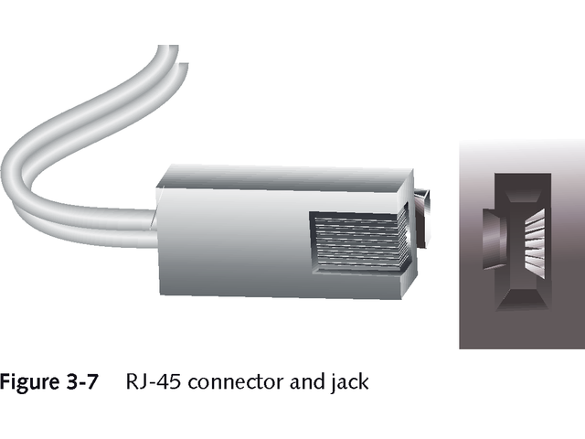
Twisted-Pair Connectors
Both STP and UTP use RJ-45 connectors
Similar to four-wire RJ-11 connectors used for telephone jacks
RJ-45 is larger and uses eight wires

Slide 43
Wiring Center Elements
Wiring center elements include:
Distribution racks, punchdown blocks, and modular shelving
Modular path panels
Wall plates
Jack couplers
Figure 3-8 shows patch panel and punchdown block
Table 3-4 summarizes characteristics of 10BaseT Ethernet

Slide 44
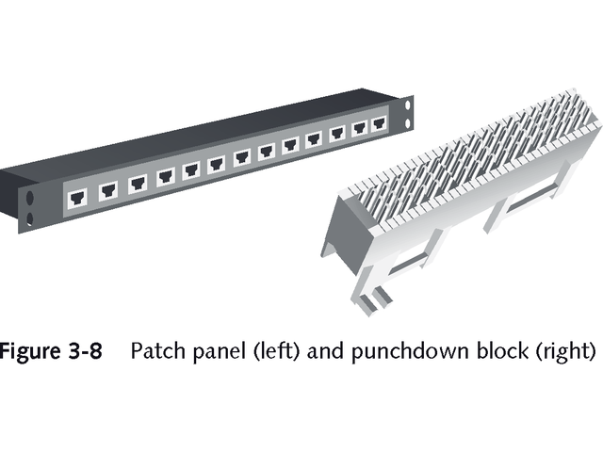
Patch Panel and Punchdown Block

Slide 45
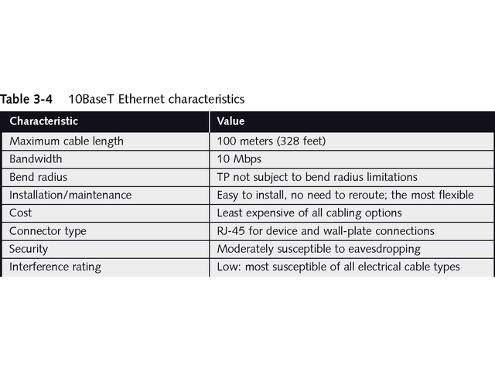
10BaseT Ethernet Characteristics

Slide 46
Fiber-Optic Cable
Uses pulses of light rather than electrical signals
Immune to interference; very secure; eliminates electronic eavesdropping
Excellent for high-bandwidth, high-speed, long-distance data transmissions
Slender cylinder of glass fiber called core surrounded by cladding and outer sheath, as seen in Figure 3-9
Plastic core makes cable more flexible, less sensitive to damage, but more vulnerable to attenuation and unable to span as long distances as glass core cables

Slide 47
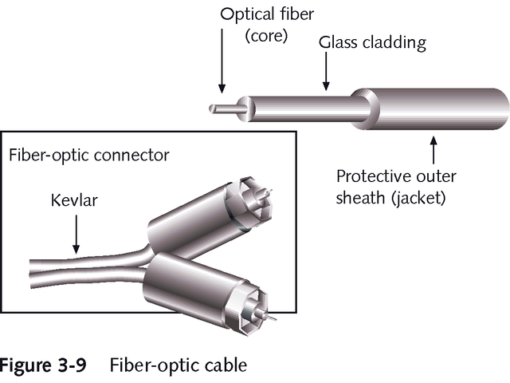
Fiber-Optic Cable

Slide 48
Fiber-Optic Cable
Each core passes signals in only one direction
Most fiber-optic cable has two strands in separate cladding
May be enclosed within single sheath or jacket or may be separate cables
Kevlar often used for sheathing
Advantages include no electrical interference, extremely high bandwidth, and very long segment lengths
See Table 3-5

Slide 49
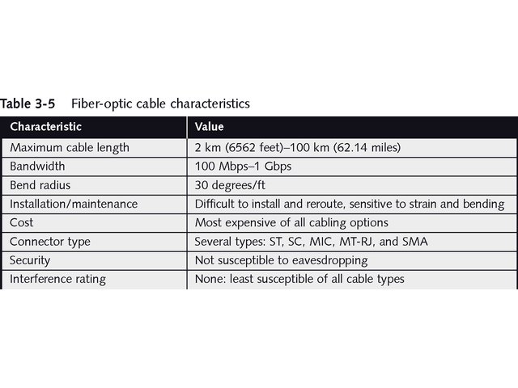
Fiber-Optic Cable Characteristics

Slide 50
Fiber-Optic Connectors
Variety of connectors:
Straight tip (ST): joins individual fibers at interconnects
Straight connection (SC): used for splicing fiber-optic cables
Medium interface connector (MIC): used for Fiber Distributed Data Interface (FDDI)
Subminiature type A (SMA): available with metal or plastic sleeve
MT-RJ: looks like RJ-45 connector, easy to connect, and saves space

Slide 51
Fiber-Optic Cables
More difficult to install and more expensive than copper media
Two primary types:
Single-mode cables: cost more; span longer distances; work with laser-based emitters
Multimode cables: cost less; span shorter distances; work with light-emitting diodes (LEDs)
Used for network backbone connections and with long-haul communications carrying large amounts of voice and data traffic

Slide 52
Cable Selection Criteria
Consider following criteria when choosing network cabling:
Bandwidth
Budget
Capacity
Environmental considerations
Placement
Scope
Span
Local requirement
Existing cable plant

Slide 53
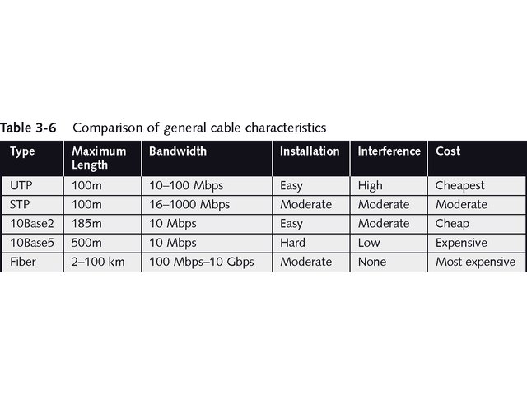
Comparison of General Cable Characteristics

Slide 54
The IBM Cabling System
IBM developed its own cabling system cable ratings
Cables use unique cable connector, designated neither male nor female, making any two connectors able to plug into each other
Require special face plates and distribution panels
Cable types designated with numbers 1 to 9 and specify diameter of conductor using American Wire Gauge (AWG) standards

Slide 55
Wireless Networking: Intangible Media
Wireless technology is increasing
Becoming more affordable
Frequently used with wired networks
Microsoft calls these hybrid networks

Slide 56
The Wireless World
Capabilities of wireless networking:
Create temporary connections into existing wired networks
Establish back-up connectivity for existing
wired networks
Extend network’s span beyond limits of cabling without expense of rewiring
Permit users to roam (also called “mobile networking”)

Slide 57
The Wireless World
More expensive than cable-based networks
Wireless networking technologies are used for
Ready access to data for mobile professionals
Delivery of network access into isolated facilities or disaster-stricken areas
Access in environments where layout and settings change constantly
Improved customer services in busy areas
Network connectivity in facilities where in-wall wiring would be impossible or too expensive
Home networks

Slide 58
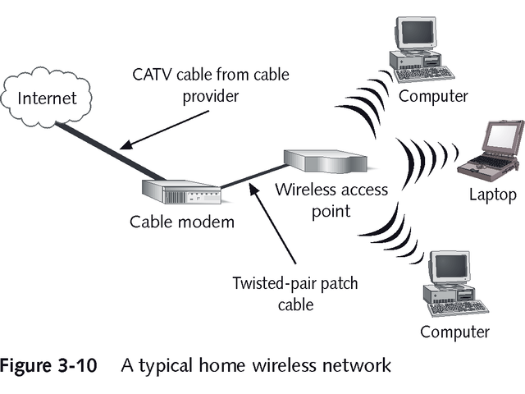
Typical Home Wireless Network

Slide 59
Types of Wireless Networks
Three primary categories of wireless networks:
Local area networks (LANs)
Extended LANs
Mobile computing
Often involves third-party communication carrier that supplies transmission and reception facilities

Slide 60
Wireless LAN Applications
Wireless LANs have similar components to wired counterparts
Network interface attaches to antenna and emitter rather than cable
Transceiver or access point translates between wired and wireless networks
Some wireless LANs attach computers to wired network by using small individual transceivers
May be wall-mounted or freestanding

Slide 61
Wireless LAN Transmission
Wireless communications broadcast through atmosphere using waves somewhere in electromagnetic spectrum
Spectrum is measured in frequencies and expressed in number of cycles per second or Hertz (Hz)
Frequency affects amount and speed of data transmission
Lower-frequency transmissions are slower but carry data over longer distances
Higher-frequency transmissions are faster but carry data over shorter distances

Slide 62
Electromagnetic Spectrum Bands
Electromagnetic spectrum is divided into ranges with higher frequencies requiring line of sight
Radio uses 10 KHz to 1 GHz
Microwave uses 1 GHz to 500 GHz
Infrared uses 500 GHz to 1 THz (TeraHertz)
Wireless LANS use four technologies:
Infrared
Laser
Narrowband, single-frequency radio
Spread-spectrum radio

Slide 63
Infrared LAN Technologies
Infrared light beams send signals between pairs of devices, using high bandwidth
Four kinds of infrared LANs include:
Line-of-sight networks require unobstructed view between transmitter and receiver
Reflective wireless networks broadcast signals to central hub and then forward them to recipients
Scatter infrared networks bounce signals off walls and ceilings
Broadband optical telepoint networks offers high speed and wide bandwidth

Slide 64
IrDA
Infrared transmissions often used for virtual docking connections
Called IrDA after Infrared Device Association
Permit laptops to communicate with individual wired computers or peripheral devices
Distance usually limited to 100 feet
Prone to interference in work environment

Slide 65
Laser-Based LAN Technologies
Laser-based transmissions require clear line
of sight between sender and receiver
Solid object or person may block data transmissions
Not subject to interference from visible light sources

Slide 66
Narrow-Band, Single-Frequency Radio LAN Technologies
Low-powered two-way radio communications
Require receiver and transmitter be tuned to same frequency
Do not require line of sight
Range is typically 70 meters

Slide 67
FCC Regulation of Radio Frequencies
In the United States, Federal Communications Commission (FCC) regulates radio frequencies
Some designated for exclusive use within specific locales
Others reserved for unregulated use (used by cellular telephones)
Most narrow-band, single-frequency wireless LAN technologies use unregulated frequencies
Anyone within range of network devices can eavesdrop
See Table 3-7

Slide 68
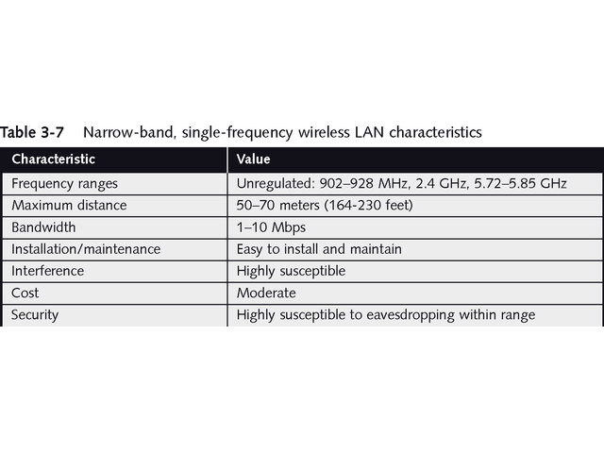
Characteristics of Narrow-Band, Single-Frequency Wireless LANs

Slide 69
High-Powered, Single-Frequency Wireless LANs
High-powered LANS may use repeater towers or signal bouncing techniques
Require more expensive transmission equipment and licensing by FCC
Some purchase service from communications carrier such as AT&T or GTE
Data often encrypted to prevent eavesdropping
See Table 3-8

Slide 70
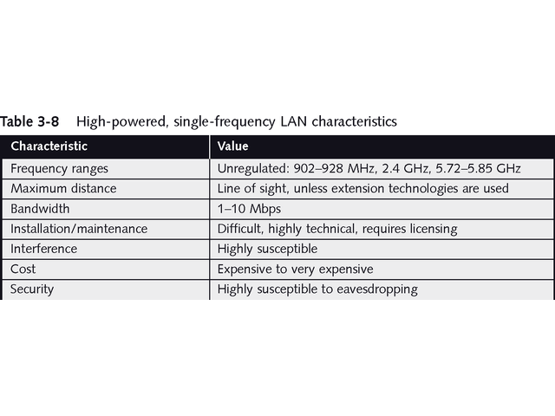
Characteristics of High-Powered, Single-Frequency Wireless LANs

Slide 71
Spread-Spectrum LAN Technologies
Spread-spectrum radio uses multiple frequencies simultaneously
Improves reliability
Reduces susceptibility to interference
Two main types of spread-spectrum communications:
Frequency-hopping
Direct-sequence modulation

Slide 72
Frequency-Hopping and Direct-Sequence Modulation
Frequency hopping switches data among multiple frequencies at regular intervals
Requires synchronized transmitter and receiver
Limited bandwidth, typically 1 Mbps or less
Direct-sequence modulation breaks data into fixed-size segments called chips and transmits data on several different frequencies at same time
Typically uses unregulated frequencies
Provides bandwidth from 2 to 6 Mbps
See Table 3-9

Slide 73
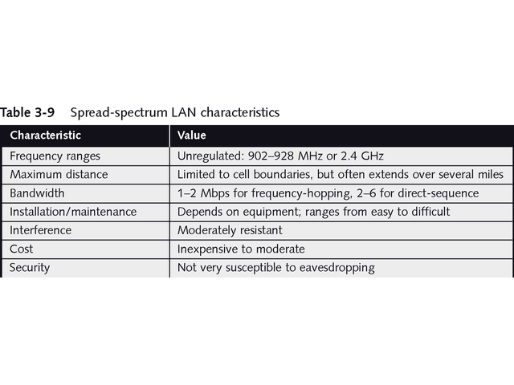
Spread-Spectrum LAN Characteristics

Slide 74
802.11 Wireless Networking
IEEE 802.11 Wireless Networking Standard resulted in inexpensive, reliable, wireless LANs for homes and businesses
802.11b standard provides bandwidth of 11 Mbps at frequency of 2.4 GHz
802.11a standard provides bandwidth of 54 Mbps at 5 GHz frequency
802.11g, to be ratified in 2003, will operate at 54 Mbps at frequency of 2.4 GHz

Slide 75
Wireless Extended LAN Technologies
Wireless networking equipment can extend LANs beyond their normal cable-based distance limitations
Wireless bridges connect networks up to three miles apart using line-of-sight or broadcast transmissions
Up-front expense may be 10 times higher, but no monthly carrier service charge
Longer-range wireless bridges work at distances up to 25 miles using spread-spectrum transmissions

Slide 76
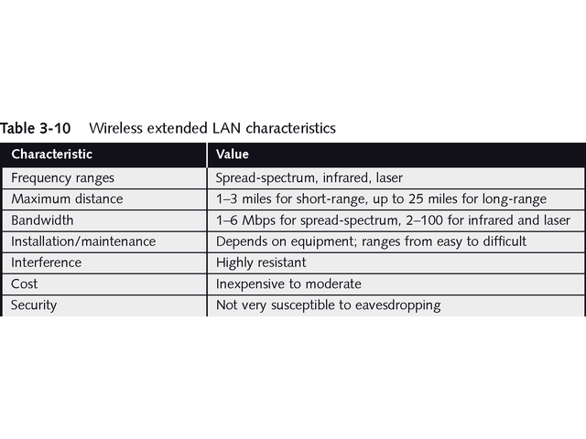
Wireless Extended LAN Characteristics

Slide 77
Microwave Networking Technologies
Microwave systems provide higher transmission rates than radio-based systems
Require line-of-sight between transmitters and receivers
Two kinds of microwave systems:
Terrestrial
Satellite

Slide 78
Terrestrial Microwave Systems
Terrestrial microwave signals require line of sight
Transmitters and receivers are mounted on tall buildings or mountaintops
Use tight-beam, high-frequency signals
Relay towers can extend signal across continents
See Table 3-11

Slide 79
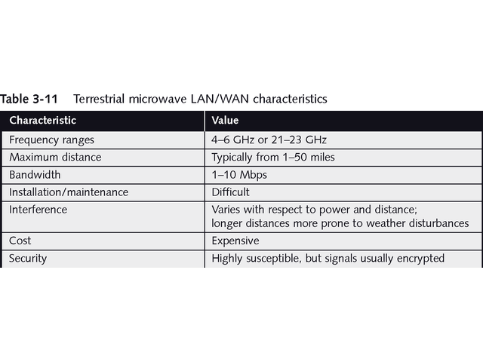
Characteristics of Terrestrial Microwave LANs/WANs

Slide 80
Satellite Microwave Systems
Use geosynchronous satellites that maintain fixed positions in sky
Used for television and long-distance telephone
Satellites receive signals; redirect them to receiver
Geosynchronous satellites orbit 23,000 miles above Earth
Transmission delays, called propagation delays, vary from .5 to 5 seconds

Slide 81
Satellite Microwave Systems
Expensive to launch satellites
Global communications carriers operate most satellites and lease frequencies
Satellite communications cover a broad area
Anyone with right reception equipment may receive signals
Transmissions are routinely encrypted
See Table 3-12

Slide 82
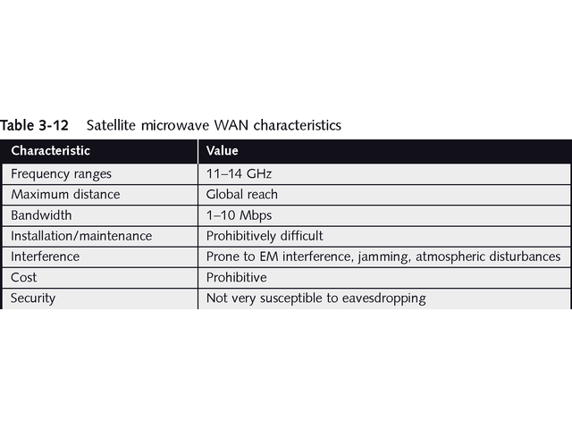
Characteristics of Satellite Microwave WANs

Slide 83
Other Wireless Networking Technologies
IEEE 802.11b Wireless Networking Standard continues to evolve with higher-speed enhancements
Cellular packet radio by Metricom Inc. offers wireless networking in three areas of US
Allows users to establishes 2 Mbps connections
Cellular Digital Packet Data (CDPA) is available in major US metropolitan areas
Allow connections at 19.2 Kbps

Slide 84
Other Wireless Networking Technologies
Motorola has scaled down plan for Iridium low-orbiting satellites to blanket earth; too expensive
Intel, Nokia, and Unwired Plant collaborated on narrow-band socket specification to connect wireless devices to Internet
Other technology companies, such as Winstar Communications Inc, intend to provide high-speed alternatives to “last mile” cable coverage
Wireless marketplace is growing and should accelerate in the future

Slide 85
Chapter Summary
Pay careful attention to user requirements, budget, distance, bandwidth, and environmental factors when choosing network media, whether wired or wireless
Choose technology that meets immediate needs and leaves room for growth and change
Wired network media includes three primary choices: twisted-pair, coaxial, and fiber-optic
Coaxial cable may be thinwire or thickwire Ethernet

Slide 86
Chapter Summary
Both types of coax use a copper core surrounded with insulation and wire braid to reduce crosstalk
Coaxial is good choice for transmitting over medium to long distances
Twisted-pair cable may be unshielded (UTP) or shielded (STP)
Rated by ANSI/EIA/TIA 568 standard, UTP has five categories with Category 5/5E used most commonly

Slide 87
Chapter Summary
STP supports higher bandwidth and longer networks spans than UTP
IBM has its own cable system with nine hierarchical rating system
New UTP categories are Cat 6 for Gigabit Ethernet and Cat 7 for special situations requiring backward compatibility
Fiber-optic cable offers highest bandwidth, best security, and least interference, but is most expensive type of cabling

Slide 88
Chapter Summary
More sensitive to stress and bending, fiber-optic requires special installation using connectors such as ST, SC, and MT-RJ
Cabled networks transmit either as broadband or baseband
Broadband transmissions use analog signals to carry multiple channels on single cable
Baseband transmissions use single channel to send digital signals that use entire cable’s capacity

Slide 89
Chapter Summary
Growing in popularity, wireless networks provide cable-free LAN access and wide-area network (WAN) links, as well as supporting mobile computing needs
Wireless networks use variety of electromagnetic frequency ranges, including narrow-band and spread-spectrum radio, microwave, infrared, and laser transmission techniques

Slide 90
Chapter Summary
Wireless bridge can extend LANs with short-range bridges spanning three miles and long-range wireless bridges spanning up to 25 miles
The 802.11b wireless standard specifies bandwidth of 11 Mbps
Two new standards, 802.11a and 802.11g, support bandwidths up to 54 Mbps

Slide 91
Chapter Summary
Mobile computing uses broadcast frequencies and communications carriers to transmit and receive signals using packet-radio, cellular, or satellite techniques
Wireless networking is expected to grow significantly with newer and more powerful techniques and standards

